Slide 1
Predicting Coronary Heart Diseases using Logistic Regression

Slide 2
Problem Statement and Business Goals
Problem statement
World Health Organization has estimated 12 million deaths occur worldwide; every year due to heart diseases. Half the deaths in the United States and other developed countries are due to cardiovascular diseases. The early prognosis of cardiovascular diseases can aid in making decisions on lifestyle changes in high risk patients and in turn reduce the complications. This research intends to pinpoint the most relevant/risk factors of heart disease as well as predict the overall risk using logistic regression. Using logistic regression I will be able to determine whether a person runs the risk of having a heart disease. The classification goal is to predict whether the patient has 10years risk of future coronary heart disease.

Slide 3
Problem Statement and Business Goals
Business Goal
I am required to use logistic regression to predict whether a patient has 10years risk of future coronary heart disease or not. I will make use of binary logistic regression in which target variable has only two possible outcomes such as heart disease or no heart disease. Hospitals and Doctors may use this model to predict which patient is at risk and preventive measures be taken.

Slide 4
Data source
The dataset is publicly available on the Kaggle website, and it is from an ongoing cardiovascular study on residents of the town of Framingham, Massachusetts. The classification goal is to predict whether the patient has 10-year risk of future coronary heart disease (CHD).

Slide 5
Technique used
Language used in this project
Python
Logistic regression is the technique I used to model my prediction
Classification techniques are an essential part of machine learning and data mining applications. Approximately 70% of problems in Data Science are classification problems. There are lots of classification problems that are available, but the logistics regression is common and is a useful regression method for solving the binary classification problem

Slide 6
Technique used
The following steps were used:
Import libraries: Import all the libraries needed for this project such as pandas sklearn.model_selection, seaborn, matplotlib.pyplot
I used pandas to read my dataset
I used some basic techniques to check and clean my data such as framigham.info(), framigham.isnull().sum() , framigham.dropna() etc
Data visualization is carried out by placing my data in a visual context such that certain patterns, trend and correlation that might not otherwise by detected can be exposed

Slide 7
Technique used
Data splitting
sklearn.model_selection is the library use to split our data into training and testing dataset.
80% is my training data and 20% my test data

Slide 8
Model development and prediction
First, import the Logistic Regression module and create a Logistic Regression classifier object using LogisticRegression() function.
Then, fit your model on the train set using fit() and perform prediction on the test set using predict().
from sklearn.linear_model import LogisticRegression
logreg = LogisticRegression()
logreg.fit(X_train,y_train)
y_pred=logreg.predict(X_test)

Slide 9

Model Evaluation using confusion matrix
A confusion matrix is a table that is used to evaluate the performance of a classification model
from sklearn import metrics
cnf_matrix = metrics.confusion_matrix(y_test, y_pred)
cnf_matrix
The dimension of this matrix is 2*2 because this model is binary classification. Diagonal values represent accurate predictions, while non-diagonal elements are inaccurate predictions. In the output 723 and 7 are actual predictions, and 113 and 5 are incorrect predictions.

Slide 10
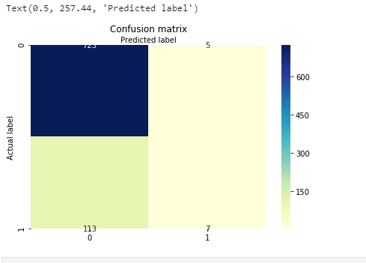

Visualizing confusion matrix using heatmap
Let's visualize the results of the model in the form of a confusion matrix using matplotlib and seaborn
print("Accuracy:",metrics.accuracy_score(y_test, y_pred))
print("Precision:",metrics.precision_score(y_test, y_pred))
print("Recall:",metrics.recall_score(y_test, y_pred))

Slide 11
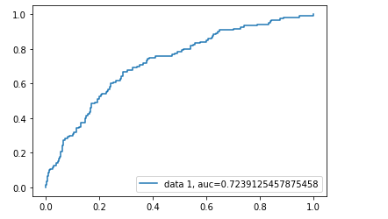
ROC curve
Receiver Operating Characteristic(ROC) curve is a plot of the true positive rate against the false positive rate
AUC score for the case is 0.72. AUC score 1 represents perfect classifier, and 0.5 represents a worthless classifier.

Slide 12
Limitation
It is vulnerable to overfitting
Later work
I will be working with a dataset that requires me to use multinomial logistic regression in which the target variable has three or more nominal categories such as predicting the type of Wine.
Conclusion
Model has adequately addressed the problem statement. It has also helped us understand how logistic regression can be used to predict heart diseases

